Slide 1
Data Science Job Market
Reshma Ahuja

Slide 2
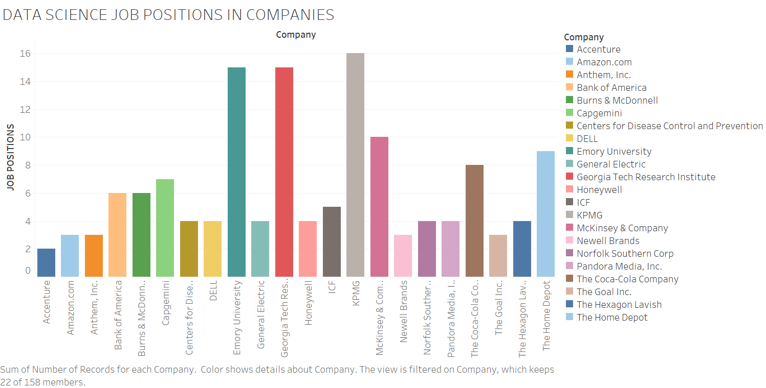

Slide 3
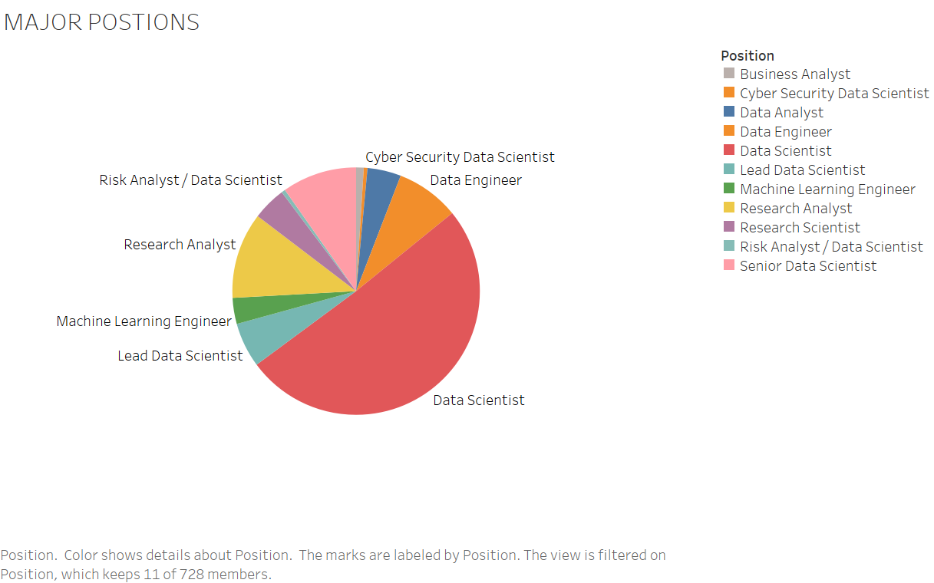

Slide 4
